Slide 1
Australian Guide to Healthy Eating 2013

Slide 2
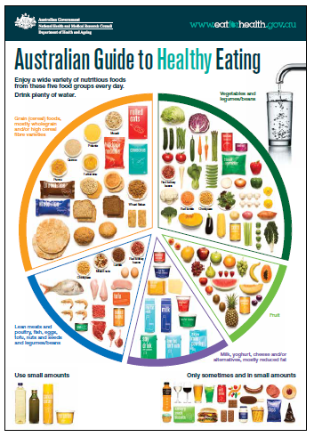

Slide 3
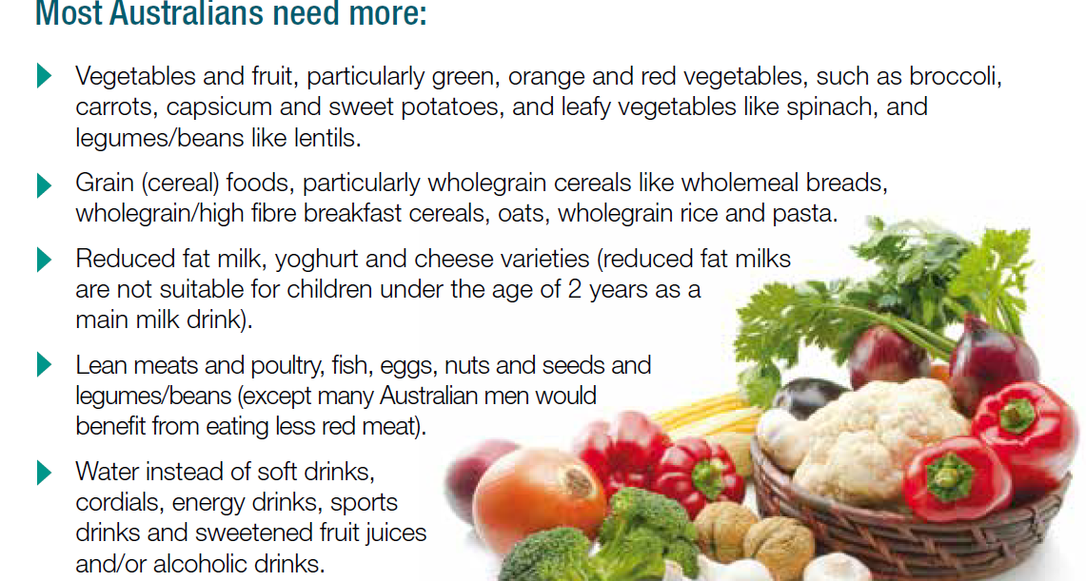

Slide 4
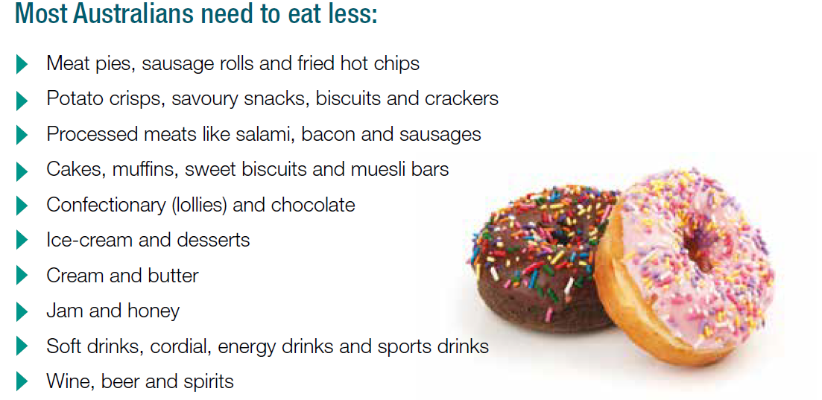

Slide 5
Guidelines
achieve and maintain a healthy weight
Enjoy a wide variety of nutritious foods from these five groups every day
Limit intake of foods containing saturated fat, added salt, added sugars and alcohol.
Encourage, support and promote breastfeeding.
Care for your food; prepare and store it safely.

Slide 6
Guideline 1
To achieve and maintain a healthy weight, be physically active and choose amounts of nutritious food
and drinks to meet your energy needs.
• Children and adolescents should eat sufficient nutritious foods to grow and develop normally. They should be
physically active every day and their growth should be checked regularly.
• Older people should eat nutritious foods and keep physically active to help maintain muscle strength and a
healthy weight.

Slide 7
Guideline 2
Enjoy a wide variety of nutritious foods from these five food groups every day:
• Plenty of vegetables of different types and colours, and legumes/beans
• Fruit
• Grain (cereal) foods, mostly wholegrain and/or high cereal fibre varieties, such as breads, cereals, rice, pasta, noodles, polenta, couscous, oats, quinoa and barley
• Lean meats and poultry, fish, eggs, tofu, nuts and seeds, and legumes/beans
• Milk, yoghurt, cheese and/or their alternatives, mostly reduced fat
And drink plenty of water.

Slide 8
Guideline 3
Limit intake of foods containing saturated fat, added salt, added sugars and alcohol.
a. Limit intake of foods high in saturated fat such as many biscuits, cakes, pastries, pies, processed meats, commercial burgers, pizza, fried foods, potato chips, crisps and other savoury snacks.
• Replace high fat foods which contain predominately saturated fats such as butter, cream, cooking margarine, coconut and palm oil with foods which contain predominately polyunsaturated and monounsaturated fats such as oils, spreads, nut butters/pastes and avocado.
• Low fat diets are not suitable for children under the age of 2 years.
b. Limit intake of foods and drinks containing added salt
• Read labels to choose lower sodium options among similar foods.
• Do not add salt to foods in cooking or at the table.
c. Limit intake of foods and drinks containing added sugars such as confectionary, sugar-sweetened soft
drinks and cordials, fruit drinks, vitamin waters, energy and sports drinks.
d. If you choose to drink alcohol, limit intake. For women who are pregnant, planning a pregnancy or
breastfeeding, not drinking alcohol is the safest option.

Slide 9
Encourage, support and promote breastfeeding.
Guideline 4
Breastfeeding is the healthiest start for infants. For the infant, breastmilk provides a unique mix of nutrients and other important substances that can reduce the risk of infection and may also help reduce the risk of asthma, eczema and other allergies, and sudden infant death syndrome.

Slide 10
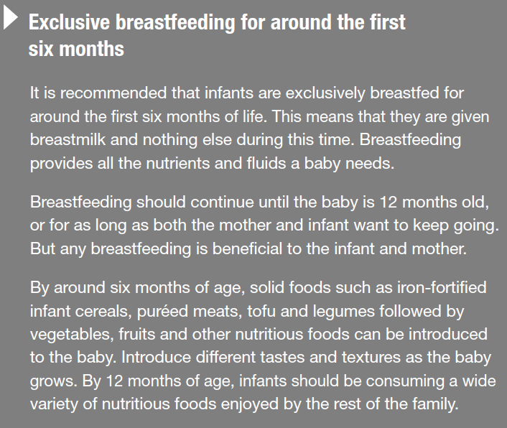

Slide 11
GUIDEline 5
Care for your food; prepare and store it safely

Slide 12
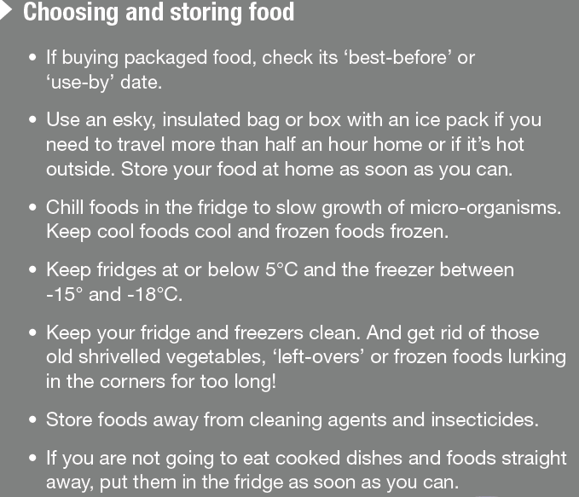

Slide 13
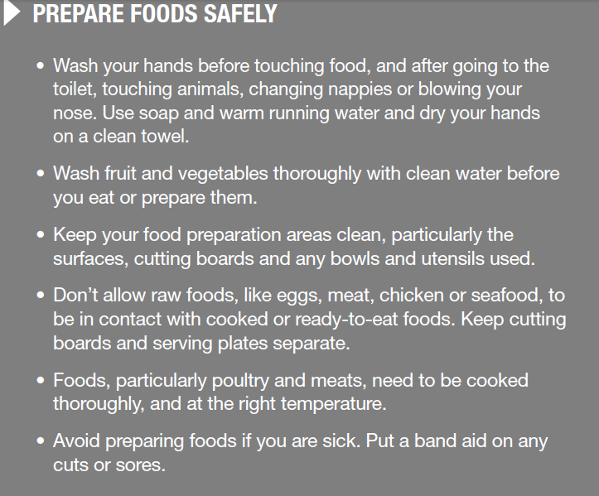

Slide 14
Australian Guide to Healthy Eating
Enjoy a wide variety of nutritious foods from these five food groups every day.
Plenty of vegetables, of different types and colours, and legumes/beans
Fruit
Grain (cereal) foods, mostly wholegrain, and/or high cereal fibre varieties such as
breads, cereals, rice, pasta, noodles, polenta, couscous, oats, quinoa and barley
Lean meats and poultry, fish, eggs, tofu, nuts and seeds, and legumes/beans
Milk, yoghurt, cheese and/or their alternatives, mostly reduced fat
And drink plenty of water.

Slide 15
How much should we eat from the vegetable group?
Most Australians eat only about half the recommended quantity of vegetables.
Try to choose different types and colours of vegetables to make sure you have enough of all necessary nutrients.

Slide 17
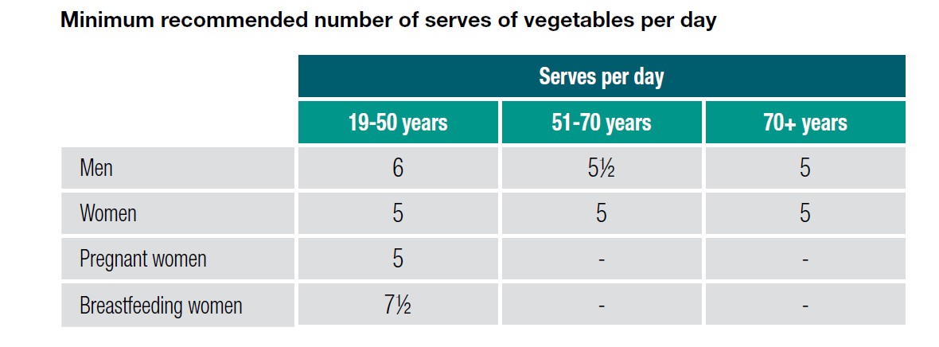

Slide 19
How much fruit should we eat?
Most Australians eat only about half the recommended quantity of fruit. However many of us drink far too much fruit juice – whole fruit is preferable to juice.

Slide 20
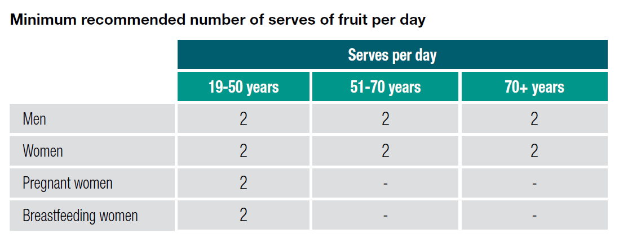

Slide 23
Go for wholegrains
The grain (cereal) group includes breads, breakfast cereals, rice, pasta, noodles, polenta, couscous, bulgur, oats, quinoa and barley. These foods are made from grains such as wheat, oats, rice, rye, barley, millet, quinoa and corn. Wholemeal or wholegrain varieties are preferable because they provide more dietary fibre, vitamins and minerals than refined grain (cereal) foods.
Eating grain (cereal) foods, mostly wholegrain, can help protect us against heart disease, type 2 diabetes and excessive weight gain and may help reduce risk of some cancers.
Grain (cereal) foods which have high amounts of added saturated fats, added sugars and/or salt such as most cakes, muffins, pies, pastries and biscuits are not included in this group but are classified under ‘discretionary choices’

Slide 24
How much grain (cereal) foods should we eat?
Most Australians consume less than half the recommended quantity of wholegrain foods, but eat too much refined grain (cereal) foods. At least two-thirds of our choices should be wholegrain varieties.

Slide 25
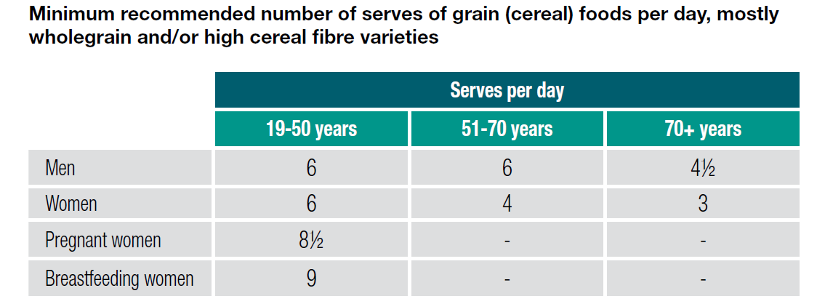

Slide 27
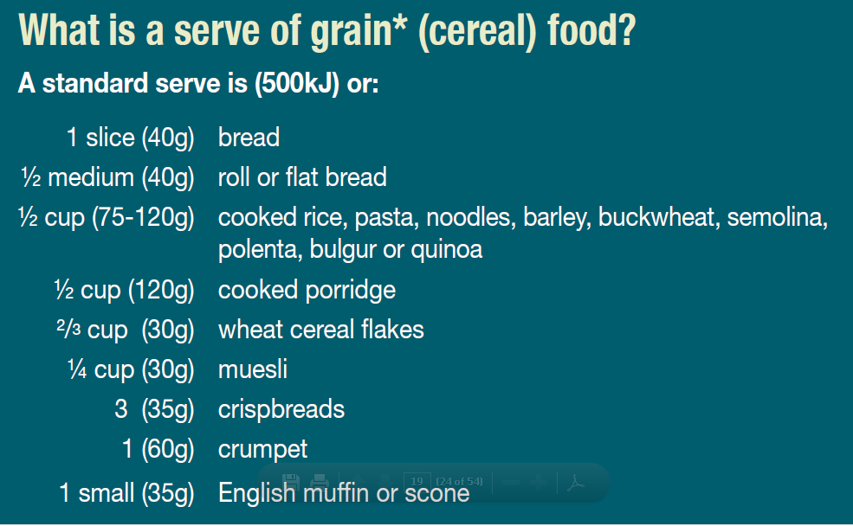

Slide 28
Choose lean meat and poultry, fish, eggs and/or plant-based alternatives
Eating a variety of foods from the group containing lean meats and poultry, fish, eggs, nuts and seeds, and legumes/beans provides many nutrients, including protein, iron, zinc and other minerals and vitamins, particularly those of the vitamin B group. Vitamin B12 is found mainly in animal-based products.

Slide 29
Lean red meat is high in iron and can be an important food, especially for some groups including infants, children, women (particularly when pregnant) and athletes. However, regular consumption of larger quantities of red meat may be associated with increased risk of colorectal cancer.
Fish, especially oily fish such as salmon and tuna, can be a valuable source of essential omega-3 fatty acids. Small quantities of these fatty acids are also found in lean grass-fed red meat, poultry and some eggs. Regular consumption of fish may help reduce risk of heart disease, stroke, dementia in older adults and macular degeneration in the eyes.

Slide 30
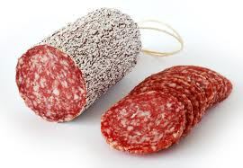
Processed meats such as salami, mettwurst, bacon and ham are not part of this food group. They are classified as discretionary choices because they are high in saturated fat and/or salt.
Consuming processed meat
may be associated with an
increased risk of colorectal
cancer.

Slide 31
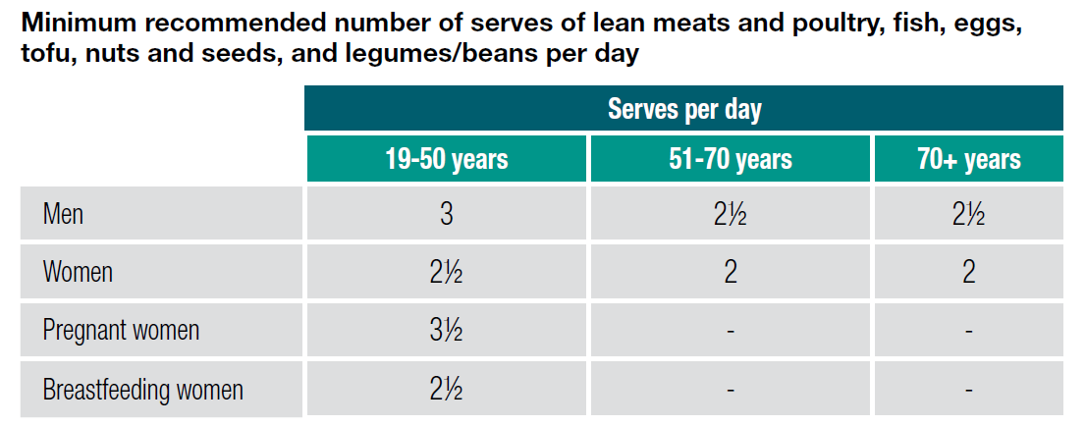

Slide 33
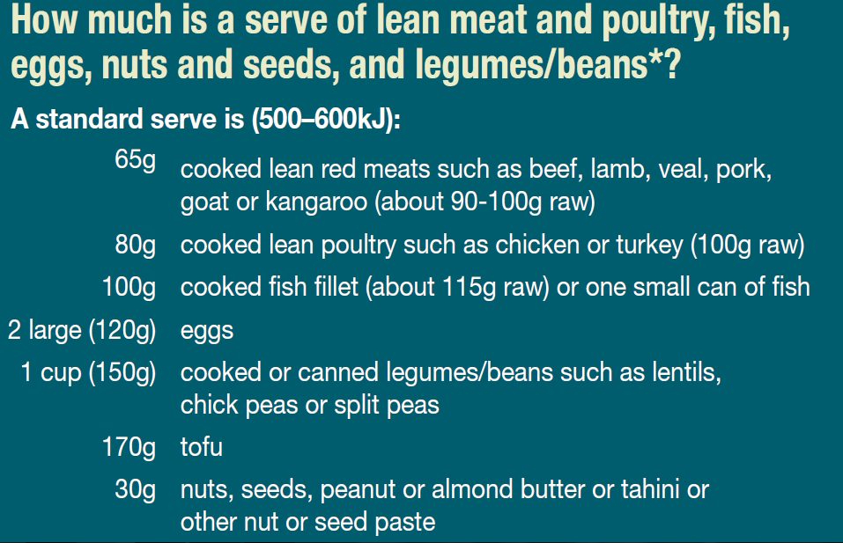

Slide 34
Include milk, yoghurt and cheese and/or alternatives— mostly reduced fat
Milk, yoghurt and cheese are rich sources of calcium and other minerals, protein, and vitamins, including B12.
Consumption of milk, yoghurt and cheese can protect us against heart disease and stroke, can reduce our risk of high blood pressure and some cancers, may reduce our risk of Type 2 diabetes and may contribute to stronger bones.

Slide 35
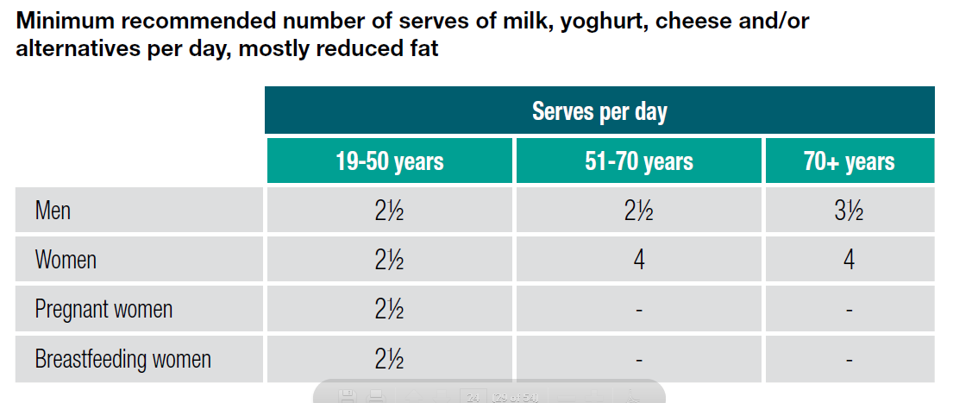

Slide 39
Water is essential for life
Australian tap water is an ideal drink – it’s inexpensive, tastes good and is safe in most areas of the country. Fluoridated tap water helps develop strong bones and teeth.
Choose water instead of drinks with added sugars or alcohol. The amount of water we need varies depending on individual factors including diet, climate and levels of physical activity.

Slide 40
What about foods and drinks that are not part of the five groups?
Discretionary choices are high in kilojoules, saturated fat, added sugars and/or salt or alcohol. Most Australians consume too many discretionary choices instead of choosing foods from the Five Food Groups.
Examples of discretionary choices include: most sweet biscuits, cakes, desserts and pastries; processed meats and sausages; ice-cream and other ice confections; confectionary and chocolate; savoury pastries and pies; commercial burgers; commercially fried foods; potato chips, crisps and other fatty and/or salty snack foods; cream, butter and spreads which are high in saturated fats; sugar-sweetened soft drinks and cordials, sports and energy drinks and alcoholic drinks.

Slide 41
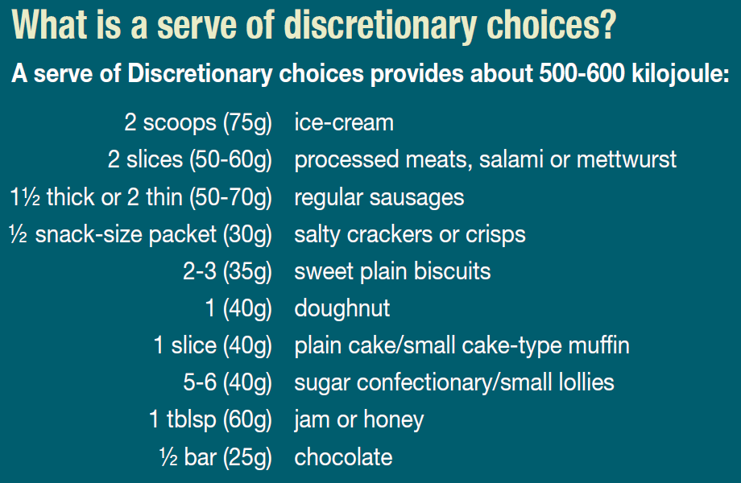

Slide 42
