Slide 1
Australian Health Care System

Slide 2
Public or Private
In Australia, there are public and private health care systems
The public system is for all Australians and is largely Government funded through our taxes
The private system is available, at an extra cost. This system also receives some Government funding

Slide 3
The federal government collects taxes and the Medicare levy which supplies part of the health care budget. The state government then contributes additional funds. Individuals and health insurance companies pay the rest

Slide 4
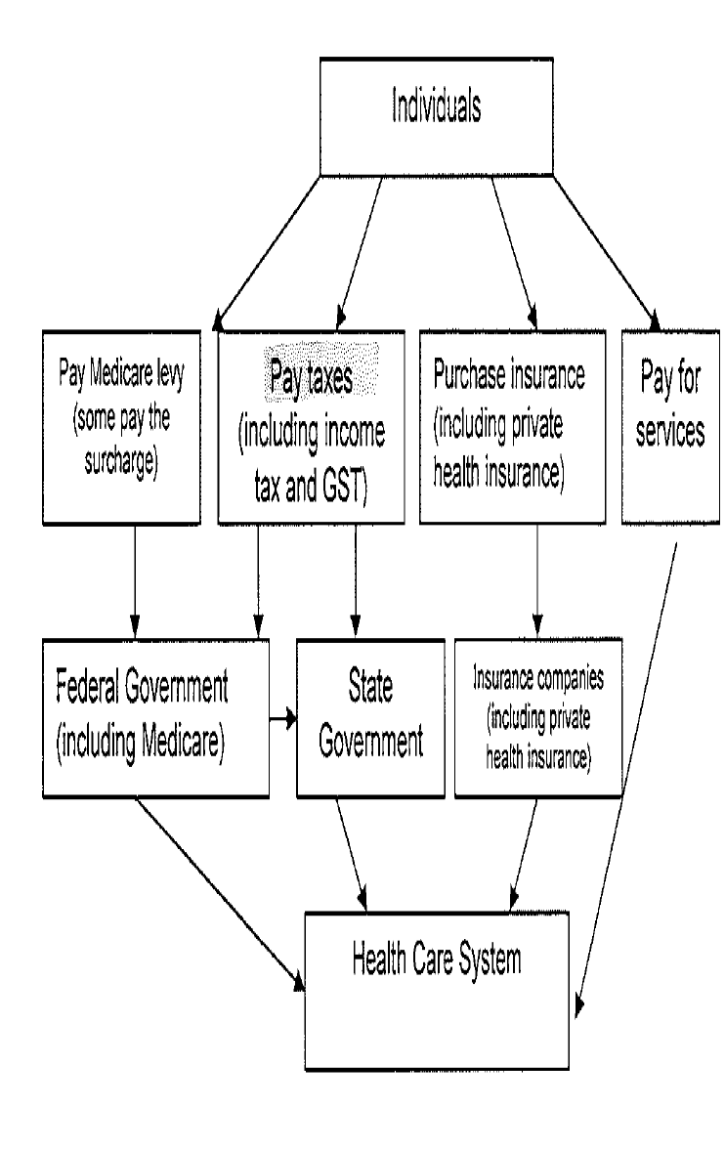
Funding

Slide 5
 | Advantages | Disadvantages
Medicare | Choice of Dr for out of Hospital service Available to all Australian citizens Reciprocal agreement b/w other countries Covers tests and examinations | No choice of Dr for in- hospital treatments Waiting list Does not cover alternate therapies Does not cover full amount of dr visits
Private health Insurance | Enables access to private health insurance Choice of Dr Shorter waiting lists Covers alternate therapies and dental, glasses 30% government rebate Lifetime cover | Costly Gap Qualifying period

Slide 6
Federal
National policies- particularly for NHPA
Provide funding for health care services and research
Fund a range of health promotion such as immunise Australia, Breast Screen and Pap Smear
Quarantine
Medicare and PBS
Age care
Regulate private health insurance
Devise food safety laws and regulations

Slide 7
State
Provide health services such as hospitals and a range of prevention programs such as Vic Health
Govern schools
Implement national Mental Health Stratergy
Ambulance
Licensing GPS, private hospital
Legislation including road rules and smoking bans

Slide 8
Local
Health inspections
Removal of waste
Water quality testing
Maintaining parks, sporting facilities
Monitoring environmental health such as noise and pollution levels
Deliver immunisation
Co-ordinate meals on wheels
Implement municipal health care plans

