Slide 1
Comparing the health status of Australians to other developed countries
Key knowledge:
Health status of Australians compared with other developed countries, including Sweden, United States of America, United Kingdom and Japan
Key skill:
Analyse data about the health status of Australia’s population and that of other developed countries

Slide 2
The overall picture
The health status of Australians is generally similar to that of other developed countries and in many cases, it is better
Australia’s level of health continues to improve
Developed countries: a country that has advanced adequately with regards to economy, technology and health status
Organisation for economic cooperation and development (OECD): an organisation of 30 developed countries, including Australia

Slide 3
Life expectancy
Australia enjoys one of the healthiest in the world
 |  | Life expectancy |  | HALE
Rank | Country | Males | Females | Males | Females
1 | Japan | 78.6 | 85.5 | 75 | 78
4 | Australia | 78.5 | 83.3 | 73 | 74
6 | Sweden | 78.4 | 82.8 | 73 | 74
18 | United Kingdom | 76.9 | 81.1 | 71 | 72
25 | United States | 75.2 | 80.4 | 69 | 71
WHO, 2009

Slide 4
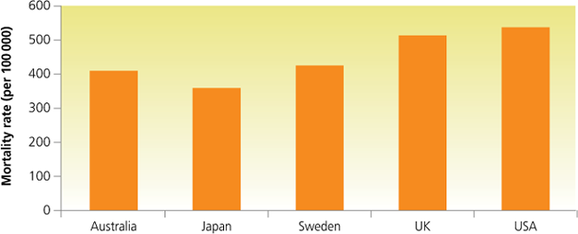
Mortality
Australia’s mortality rates from all causes are among the lowest in the world, consistent with Australia’s relatively high life expectancy.
Australia could improve rates of obesity, injury and diabetes
Age-standardised mortality rates (per 100 000) for selected developed countries Source: WHO.

Slide 5
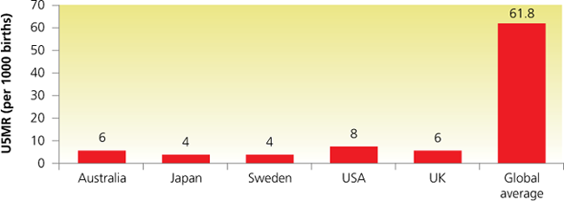
Mortality
The U5MR rate is also low compared to global averages
Not as low as Sweden and Japan, indicating room for improvement
U5MR in Australia is among the lowest in the world. Source: United Nations

Slide 6
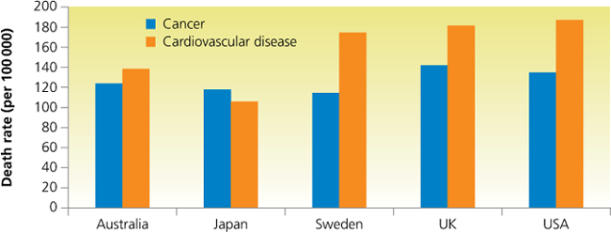
Mortality
The leading causes of death in Australia are similar to those in other developed countries (cancer and cardiovascular disease)
This is possibly a reflection on the similar lifestyles that Australians share with these countries
Age-standardised death rates per 100 000 for cancer and cardiovascular disease (2002) in selected developed countries Source: WHO.

Slide 7
Morbidity
The causes of morbidity in Australia are similar to those in other developed countries
A decrease in mortality rates has resulted in increased morbidity rates for many conditions
Lifestyle diseases tend to dominate morbidity data in developed countries ( compared to communicable diseases in developing countries)
Major causes of morbidity in all five countries
Obesity | Depression and other mental illnesses

Slide 8
Morbidity
Australia are currently one of the most overweight/obese populations in the world behind the USA. Japan has significantly lower rates compared to Australia, USA, Sweden and UK
Japan has one of the highest suicide rates in the world
USA has the highest rate of mental illness in the world
Mental disorders contribute most to the YLDs in Australia
Cancer contributes most to the YLLs in Australia

Slide 9
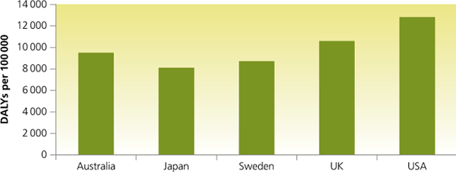
Burden of disease
Japan and Sweden experience less DALYs per person compared to Australia, UK and USA
Estimated DALYs per 100 000 (age standardised) in selected developed countries, 2002 Source: WHO.

Slide 10
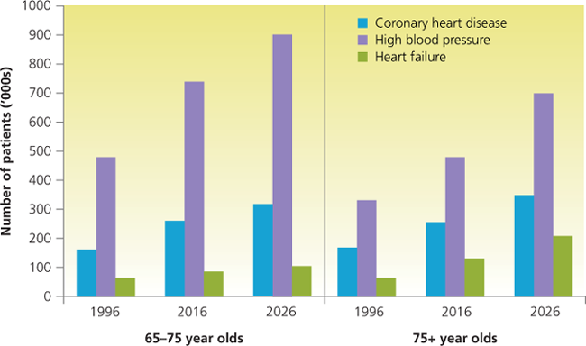
PRACTICE EXAM QUESTION
Projected numbers of older patients with certain heart, stroke and vascular conditions, Australia
Question 1
Identify two trends in the rates of cardiovascular disease.
Question 2
Suggest two reasons for the changes indicated in question 1.

