Slide 1
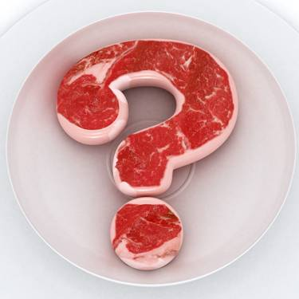
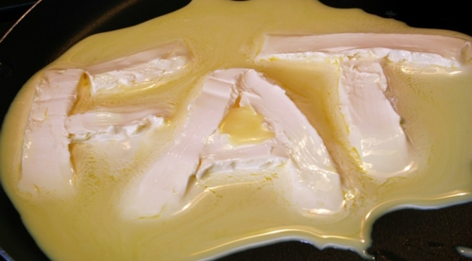
Macronutrients

Slide 2
Types of nutrients
Carbohydrate (including fibre)
Fats
Protein
Vitamins
Water
Minerals

Slide 3
Macro vs. Micro
Macronutrients:
A nutrient that is needed by the body in relatively large amounts
Carbohydrates
Protein
Lipids (fats)
Micronutrients:
A nutrient that is required by the body in small amounts
Vitamins
Minerals
Water

Slide 4
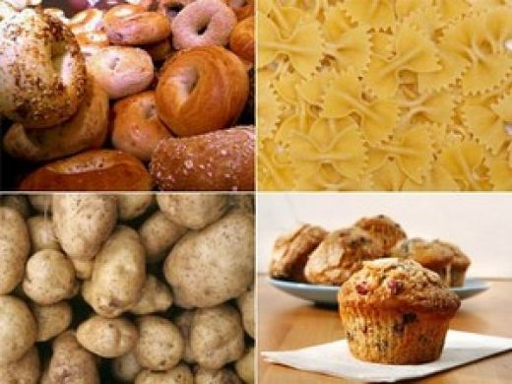
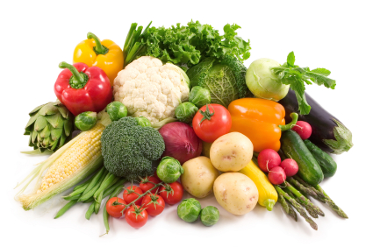
Carbohydrates – Recap
Functions:
Glucose is the body’s preferred fuel source for energy (1g CHO = 16kJ energy)
The brain and central nervous system need a continuous supply of glucose to function
Creates a protein-sparing action
Gives sweetness and flavour to food

Slide 5
Carbohydrate Classifications
Simple Carbs:
Monosaccharides (one unit of sugar)
Glucose (sugar, honey, lollies, cakes, buscuits, fruit)
Fructose (fruit, honey, some vegetables)
Disaccharides (two units of sugar)
Sucrose (sugar, maple syrup, fruit, vegetables)
Lactose (milk, milk products)
Complex Carbs:
Polysaccharides (multiple units of sugar)
Starch (breads, cereals, rice, pasta, legumes

Slide 6
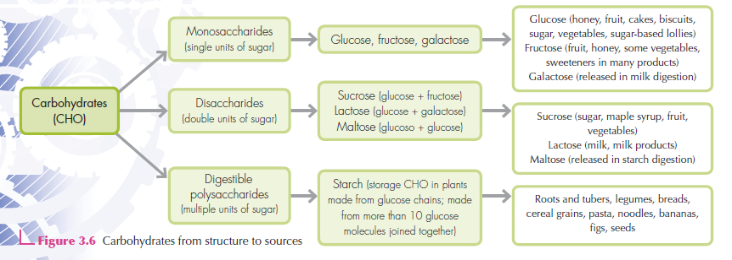

Slide 7
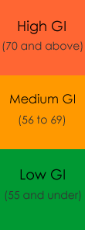
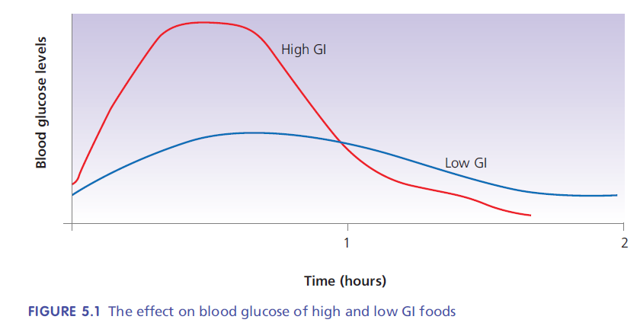
Glycaemic Index
The glycaemic index is a scale that measures the effect that carbohydrate foods have on blood glucose levels (0-100)

Slide 8
Glycaemic Index
High GI foods: (>70)
Those that cause a sharp increase in blood glucose
eg. white bread, jasmine rice, potatoes, potato chips, watermelon, some breakfast cereals, lollies, sports drinks
Low GI foods: (<55)
Those that release glucose into the blood stream more gradually
eg. sweet potato, some fruits (apples, pears, oranges), wholemeal breads, nuts, wholemeal spaghetti, yoghurt,

Slide 9
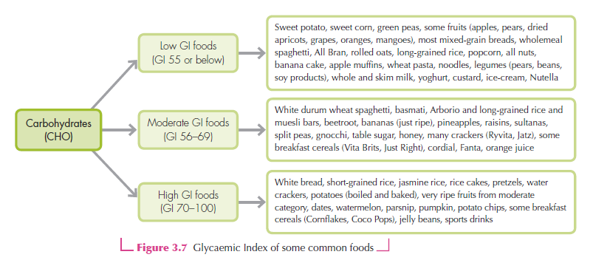

Slide 10
Fibre
Made up of the indigestible parts of plant matter
Adds bulk to faeces (soft, bulky faeces easier to pass)
Helps move waste products through digestive tract (cleaner)
Provides feeling of fullness
Helps control blood glucose levels by reducing absorption of glucose from the small intestine
Promotes regular bowel movements
Insoluble fibre:
Does not dissolve in water, but can bind with it
eg. bran, skin of fruits/veg, nuts, seeds
Soluble fibre:
Dissolves or swells in water
eg. citrus fruits, veg, oat bran, lentils, peas, soy products

Slide 11
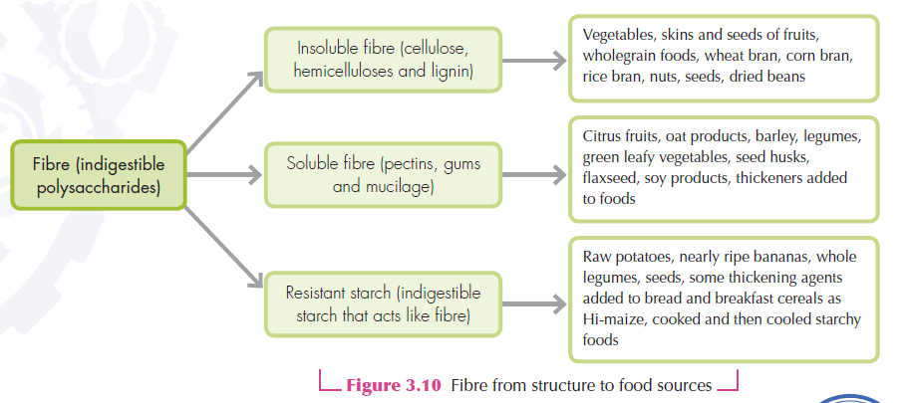

Slide 12
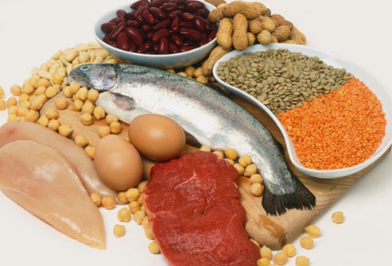
Protein - Recap
Functions:
Builds maintains and repairs body cells
(muscle, bone, organs, blood)
Secondary fuel source for energy
Transports substances throughout the body
1g protein = 17kJ energy
Made up of amino acids (building blocks)

Slide 13
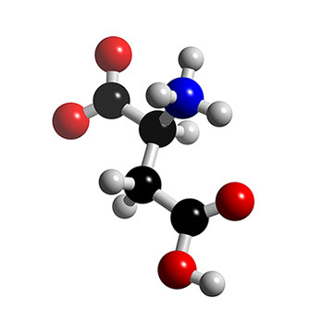
Amino Acids
20 different types
11 non-essential (can be made by body)
9 essential (must be consumed)

Slide 14
Protein Classifications
Complete proteins:
Contain all essential amino acids
Animal sources
eg. meat, poultry, dairy, eggs, soy beans (plant exception)
Incomplete proteins:
Lacking required amount of essential amino acids
Plant sources
eg. nuts, oats, lentils, tofu
Complimentary proteins:
One or more incomplete proteins that when consumed together, equal complete proteins
eg. nuts/seeds + legumes, soybeans + grains/nuts/seeds

Slide 16
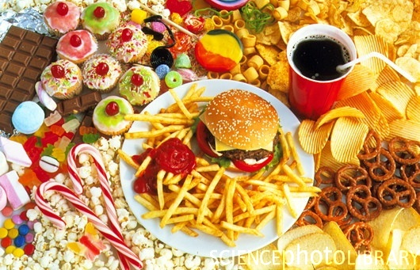
Lipids (fats)

Slide 17
Functions
Provide a concentrated source of energy
1g fats = 37kJ energy – (hence term “energy dense”)
Fats are stored in adipose (fatty) tissue for use when other energy sources are in short supply
Provide essential fatty acids
Omega 3 and omega 6: cannot be made by the body & must be consumed as part of the diet. They are important parts of cell membranes and help form blood clots and help the body respond to inflammation, injury & infection
Carry fat-soluble vitamins into the body (A, D, E & K)
Development & maintenance of cell membranes

Slide 18
…Functions…
• Satisfy hunger: Fats slow down the emptying of the stomach and therefore delay hunger sensations.
• Add to the sensory appeal of foods: Fats lubricate food, making it easier to chew and swallow. Fats add flavour and texture to food, which improves the pleasure of eating and can improve appetite.
• Insulate the body against temperature extremes: Fat is a poor conductor of heat so the layer of fatty tissue under the skin helps to keep the body warm.
• Act as a natural shock absorber: Fat pads under the heels protect the foot when walking and fat pads around bones and vital organs such as the kidneys help to protect delicate organs when a person falls or is injured.

Slide 19
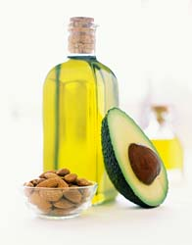
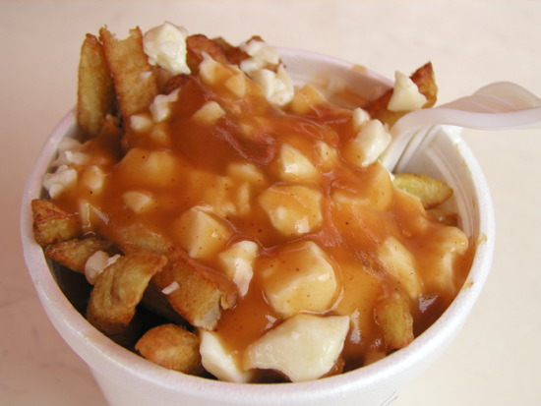
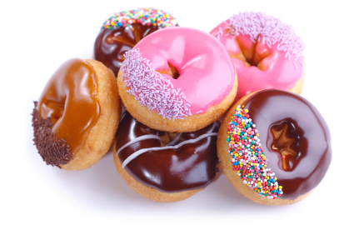
The Good, the Bad & the Ugly

Slide 20
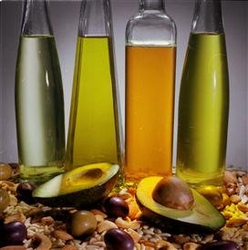
Unsaturated Fats
Monounsaturated:
‘Good’ fats
Fatty acids that have a single double bond in the fatty acid chain, with the remainder of the carbon atoms in the chain being single-bonded
Should equal highest proportion of fat intake
Liquid/soft at room temp
eg. olive oil, avocado, canola oil, nuts, peanut butter

Slide 21
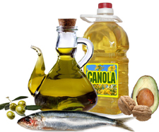
…Unsaturated Fats…
Polyunsaturated fats:
Also ‘good’ fats
Fatty acids in which more than one double bond exists in the molecule
Certain polyunsaturated fatty acids
(omega 3 and omega 6)
cannot be made by the
body and therefore need
to be consumed in the diet

Slide 22
Omega 3 and 6
These fats have been linked to a number of benefits including:
Reducing high blood pressure
The prevention of cancer, CHD and CVD
Increased immune system function
Role in brain function, memory & concentration
Omega 3 food sources:
Fish (particularly oily fish – tuna, salmon, sardines), canola & soy oils, canola-based margarines
Omega 6 food sources:
Nuts, seeds, oil made from corn, safflower & soy

Slide 23
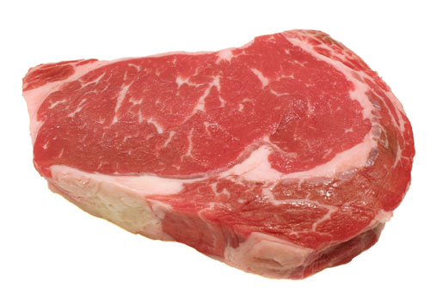
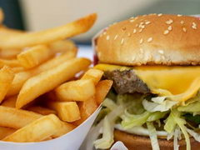
Saturated Fats
‘Bad’ fats
Generally of animal origin
Associated with many chronic conditions
eg. high cholesterol, high blood pressure, heart disease, obesity, stroke
Usually solid at room temperature
eg. fatty meats, full-cream milk, cream, cheese, fried take-away, most baked goods (pastries etc.)

Slide 24
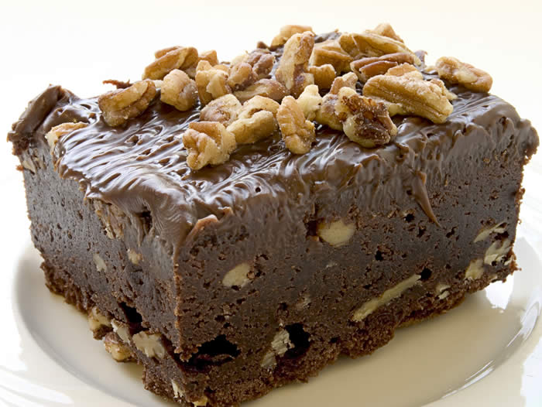
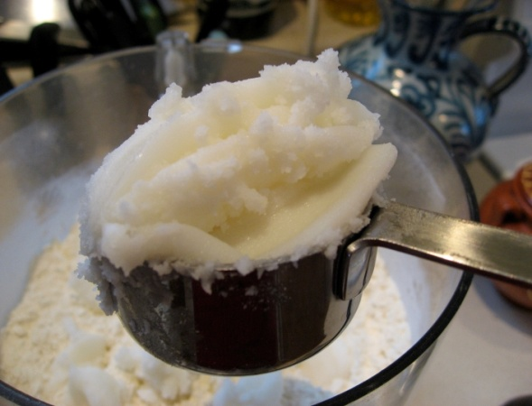
Trans Fats
‘Ugly’ fats
Have a more adverse effect on cardiovascular health than saturated fats
In most cases, trans fats are created by liquid oil being converted to solid fat via hydrogenation – used in cooking
Eg. Processed foods –
pies, pastries, cakes,
margarines/butters

Slide 25
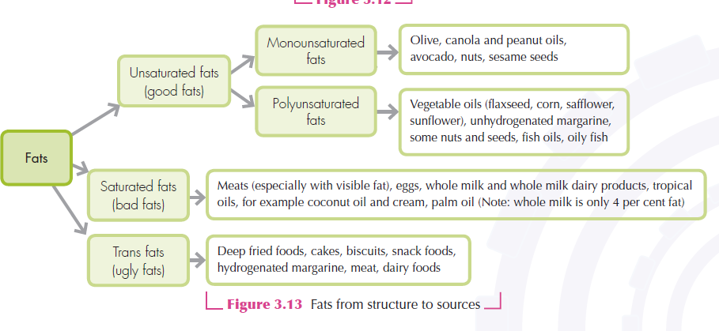

Slide 26
Cholesterol
A waxy fat found in saturated fats
Helps from cell membranes
Important role in hormone, bile & vitamin D production
Approximately two-thirds of the body’s total cholesterol is made by the body’s cells and the remaining third is consumed in foods from animal sources that contain fat
Not water soluble – Liver packages it inside lipoproteins for transportation through the blood
Food sources:
Meat , dairy products, eggs

Slide 27
LDLs / HDLs
Low density lipoproteins (LDLs):
“Bad” cholesterol
Carries most cholesterol in blood
Role in deposition of plaque (fats) in arteries
narrows arteries, increasing BP (hypertension)
Hardens artery walls (atherosclerosis)
Can lead to plaque rupture, releasing large amount of cholesterol into the blood stream → clotting → heart attack

Slide 28
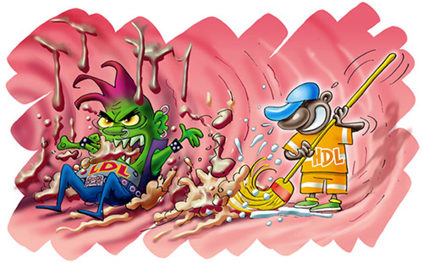
LDLs / HDLs
High density lipoproteins (HDLs):
“Good” cholesterol
Carries cholesterol from the blood back
to the liver for elimination
Also removes plaqu build-up from arteries

Slide 29
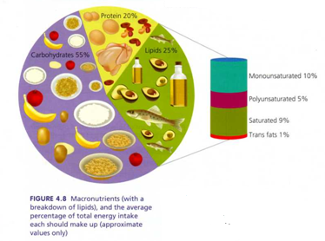
Macronutrient Intake

